Slide 1
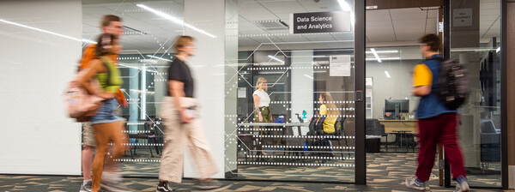
Namig Abbasov, PhD
Digital Humanities and Analyst
Data Science and Analytics
Arizona State University
Open Lab 1: Introduction to Machine Learning

Slide 2
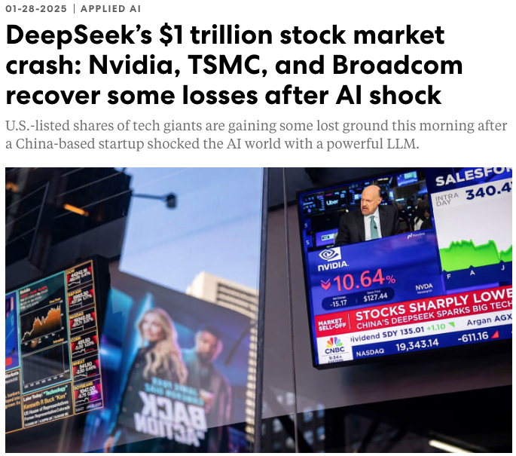
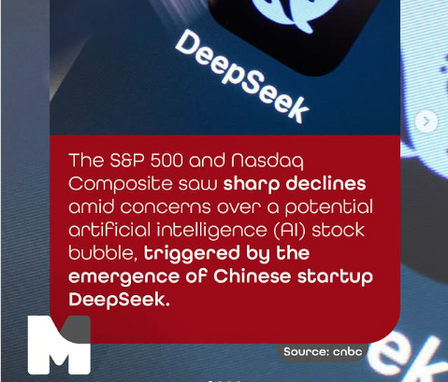
AI Transforming Our Lives…
Notes:
https://www.fastcompany.com/91268132/deepseek-ai-stock-market-crash-today-nvidia-tsmc-gain-ground

Slide 3
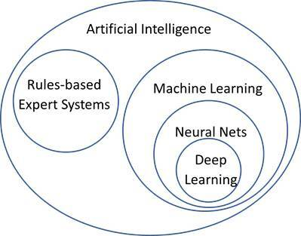
AI vs ML vs DP
Artificial Intelligence
capability of machines to imitate intelligent human behavior
Machine Learning
algorithms that allow computers to perform tasks without explicitly being programmed ​
Deep Learning
algorithms inspired by the structure and function of the brain called neural networks

Slide 4
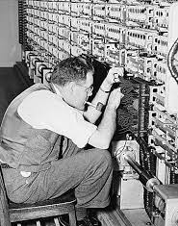
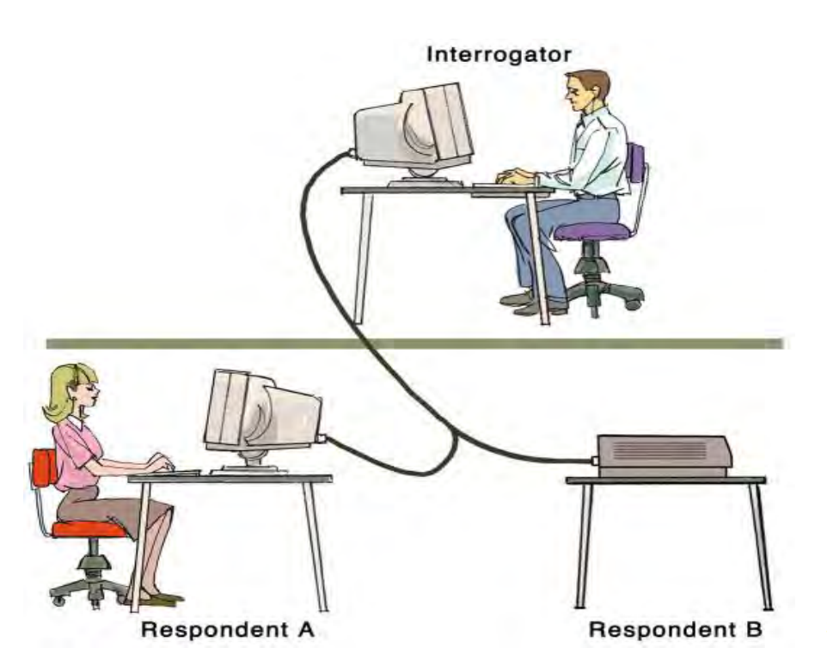
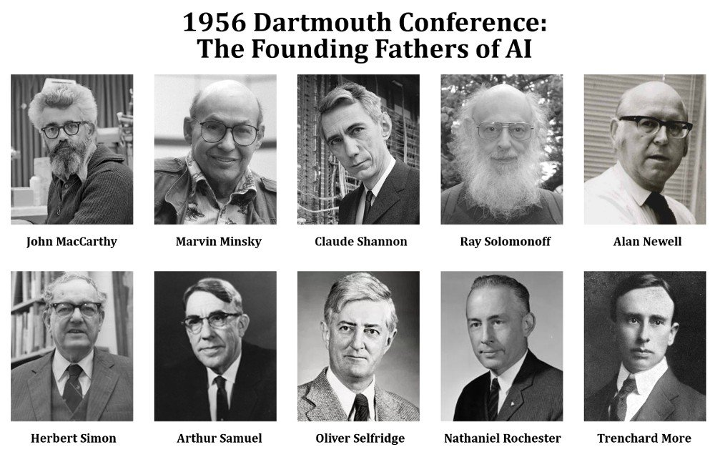
Can Machines Think?
“Imitation game” by Alan Turing
Human, Machine, Interrogator

Slide 5
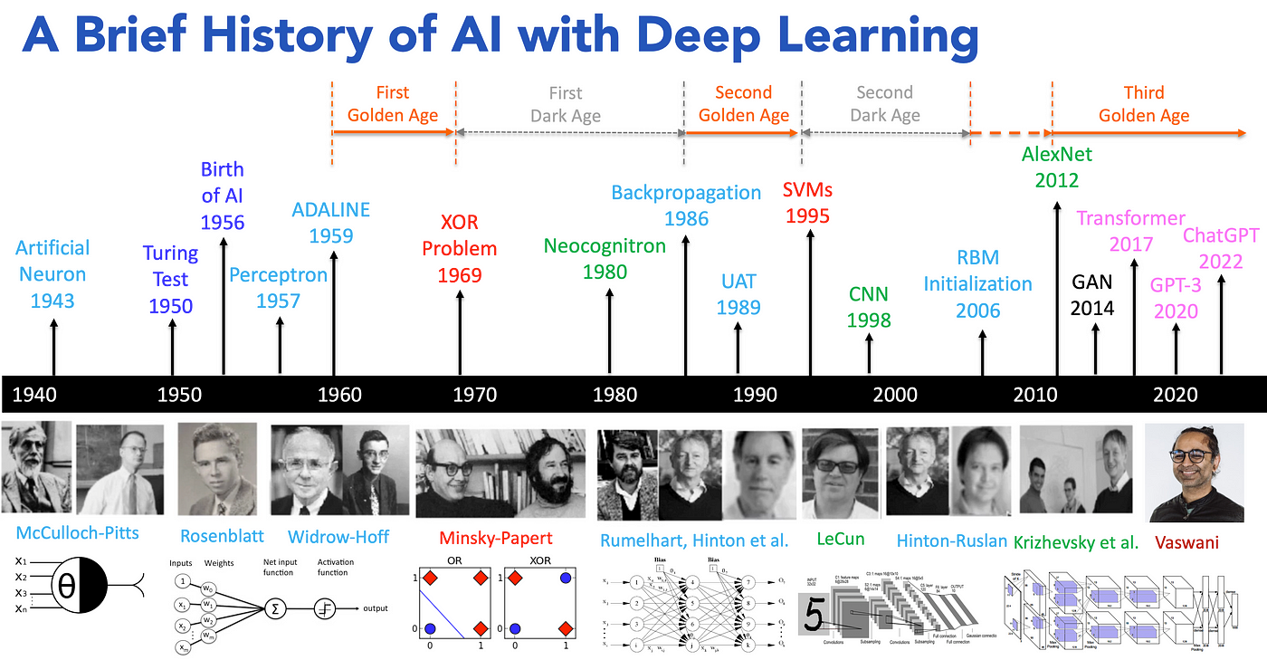

Slide 6
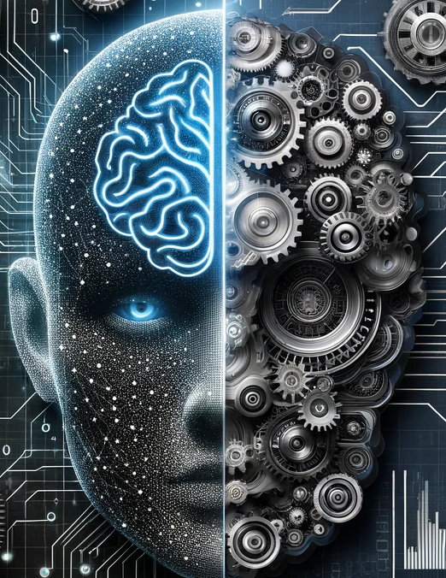
Two Primary Approaches in AI: ML vs Expert Systems
Rule-based system
Expert-driven system
If-then rules to make decisions and perform tasks
Give loan if income >50,000
credit card fraud if geographic anomaly
anomaly-based detection rules
signature-based detection rules
Downside: new threats, fraud tactics etc.
Machine learning
Automatically learn and improve from experience without being explicitly programmed
Data-driven approach
Downside: lack of data- simulation data scientist

Slide 7

Machine Learning vs. Traditional Programming
Nature
Traditional programming is rule-based, while ML is data-driven.
Flexibility
ML can adapt and improve over time with more data, while traditional software remains static unless manually updated.
Complexity
ML can handle tasks that are too complex to manually code, like natural language processing or computer vision.
Interpretability
Traditional programming is typically more interpretable because the rules are explicit, while ML can sometimes act as a black box.

Slide 8
Machine Learning in Nutshell
Branch of artificial intelligence that enables computers to learn and adapt without specific programming instructions
Uses data and algorithms to emulate human learning, enhancing its precision over time
Allows computers to derive insights from data and make informed decisions accordingly.
Coined in 1959 by Arthur Samuel
Often called as predictive modeling

Slide 9
Types of Machine Learning
Supervised Learning
Unsupervised Learning
Semi-Supervised and Transfer Learning
Reinforcement Learning

Slide 10
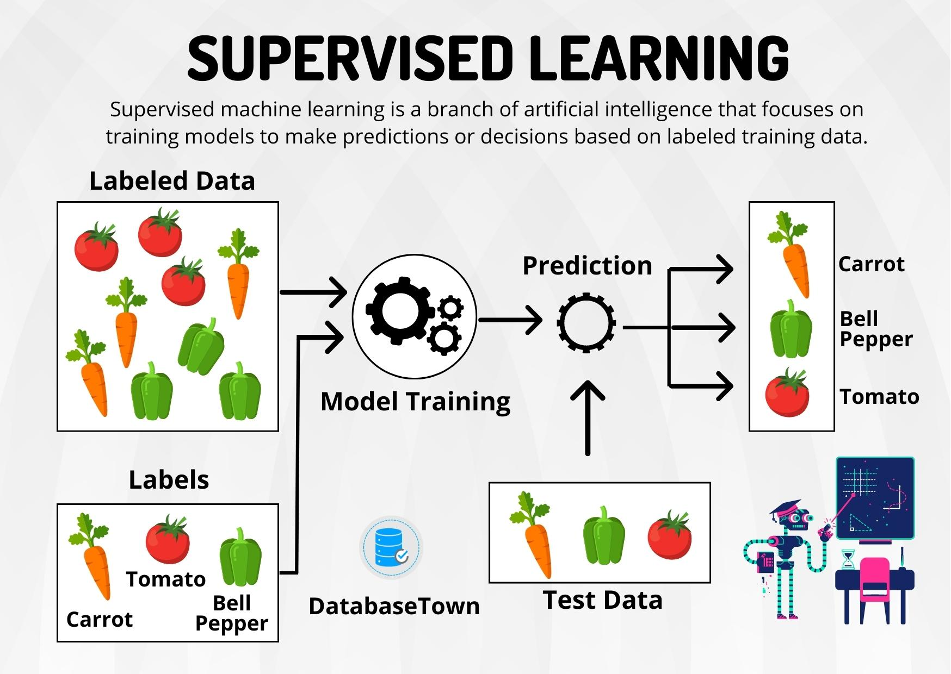

Slide 11

Supervised Machine Learning
Definition: A method where a machine learning model is trained on a labeled dataset, meaning the algorithm is provided with input-output pairs.
Key Characteristics of Supervised ML
Uses labeled data
Train, validation, Test
Predictive Modeling
Generalization
Performance Metrics
Regression: MAE, MSE, RMSE, R-squared
Classificatin: accuracy, precision, recall, F1-score. ROC Curve, AUC
Risk of Overfitting
Regularization(lasso and ridge regression), cross-validation, pruning
Feature Importance (Random Forrest)

Slide 12
Supervised ML Tasks
Regression
Predicts a continuous outcome. For instance: house price predicted by number of bedrooms, area, location
Classification
Assigns a label from a predefined set to an instance. For instance: is an email spam or ham(not spam).
Image Labeling
Associating images with labels. For instance: is an image a cat, dog, or a bird.

Slide 13
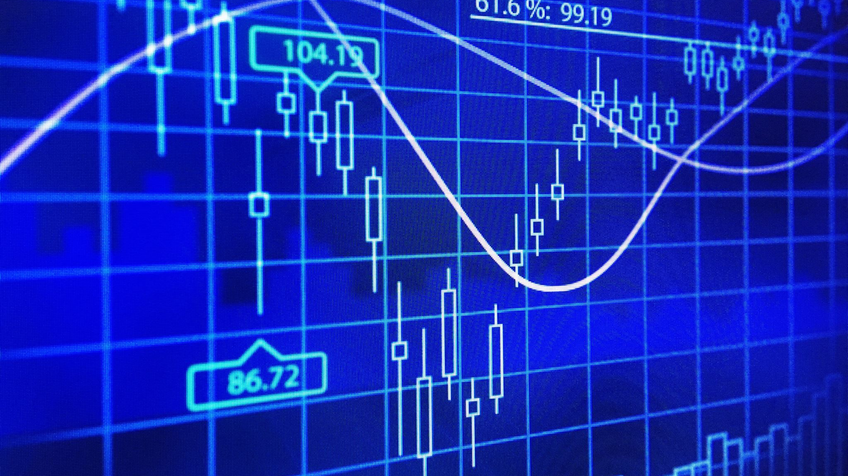
Supervised Algorithms
Linear Regression:
Purpose: Used for regression problems.
Description: It establishes a relationship between the dependent and independent variable(s) using a best fit straight line.
Use Cases: Predicting house prices, sales forecasting, risk assessment in finance.
Logistic Regression:
Purpose: Despite its name, it's used for binary classification problems.
Description: It estimates the probability that a given instance belongs to a particular category.
Use Cases: Email spam detection, customer churn prediction, medical diagnosis.
Support Vector Machines (SVM):
Purpose: Can be used for both regression and classification but is more commonly used for the latter.
Description: It finds the optimal hyperplane or boundary that best separates data into classes.
Use Cases: Face detection, handwriting recognition, classifying images.

Slide 14

Supervised Algorithms
Decision Trees and Random Forests:
Decision Trees:
Description: A flowchart-like tree structure where each internal node represents a feature.
Use Cases: Credit risk analysis, medical diagnosis.
Random Forests:
Description: An ensemble of decision trees, typically trained with the "bagging" method.
Use Cases: Banking, e-commerce
k-Nearest Neighbors (k-NN):
Purpose: Mainly used for classification but can be employed in regression as well.
Description: Classifies a data point based on how its neighbors are classified.
Use Cases: Recommender systems, image recognition.
Gradient Boosting Machines (e.g., XGBoost, LightGBM):
Purpose: Used for both regression and classification.
Description: Builds an additive model in a forward stage-wise fashion
Use Cases: Anomaly detection, ranking problems, predictive modeling in diverse domains.

Slide 15
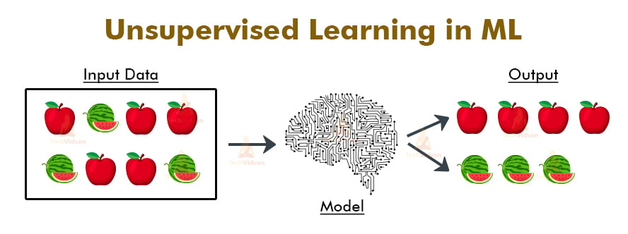
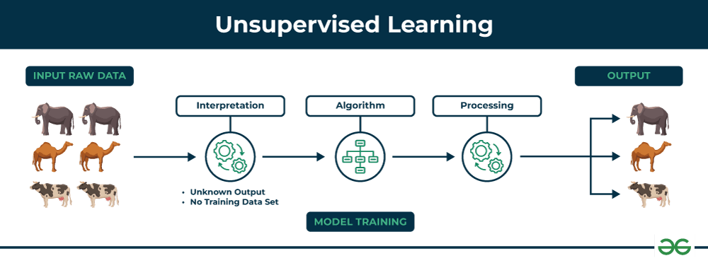
Notes:
https://vitalflux.com/different-types-of-machine-learning-models-algorithms/

Slide 16

Types of Problems in Unsupervised Learning
Clustering
Grouping data points that are similar to each other.
Analogy: Messy Closet
Dimensionality Reduction
Reducing the number of features in the data while preserving its structure or variance.
Analogy: Summarize a book
Association Rule Learning
Finding interesting relations or associations between variables in large datasets
Bread - >butter

Slide 17


Slide 18
Unsupervised ML Algorithms
Clustering Algorithms:
K-means Clustering: splits a dataset into 'k' clusters
Hierarchical Clustering: creates a tree of clusters.
DBSCAN (Density-Based Spatial Clustering of Applications with Noise): creates clusters based on the density of data points.
Gaussian Mixture Models (GMM): Assumes that data is generated from several Gaussian distributions.
Dimensionality Reduction Algorithms:
Principal Component Analysis (PCA): Reduces dimensions of the data by projecting it onto a lower-dimensional subspace while preserving the maximum variance.
t-Distributed Stochastic Neighbor Embedding (t-SNE): suitable for visualizing high-dimensional data in two or three dimensions.
Autoencoders: Neural networks used to reduce dimensionality by encoding the data into a compressed representation and then decoding it back.
Association Rule Learning Algorithms:
Apriori: Identifies frequent item sets from a dataset and is commonly used for market basket analysis.
Eclat (Equivalence Class Clustering and bottom-up Lattice Traversal): A faster alternative to the Apriori algorithm that focuses on vertical data format instead of horizontal.

Slide 19
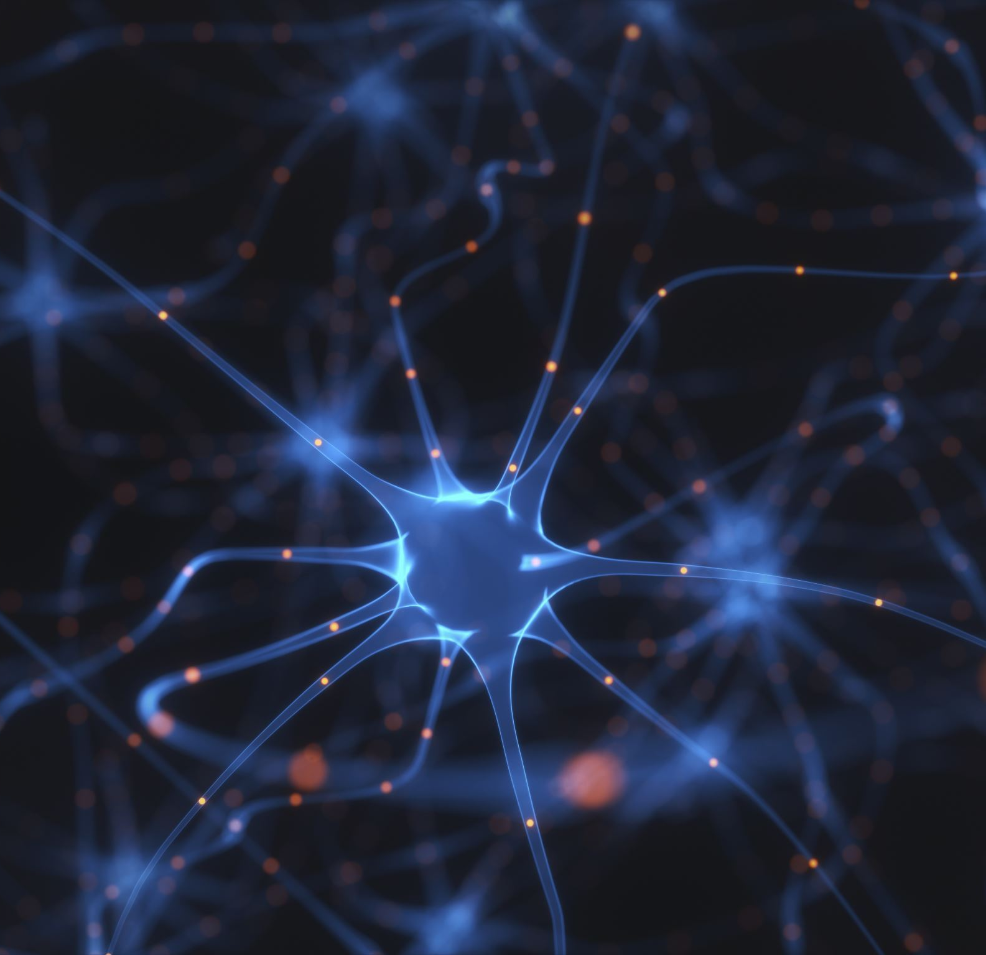
Unsupervised ML Algorithms
Neural Network-based Algorithms:
Self-Organizing Maps (SOMs)
One-Class SVM
Latent Dirichlet Allocation (LDA)
Latent Semantic Analysis (LSA)
Topic Modeling:
Non-Negative Matrix Factorization (NMF)
Generative Adversarial Networks (GANs)
Anomaly Detection Algorithms:
Isolation Forest

Slide 20

Semi-Supervised Learning
Both Labeled and Unlabeled
Semi-Supervised Approaches
Co-training
Multi-view training
Self-training (pseudo-labeling)
Applications
Image and speech recognition where labeling data is costly.
Bioinformatics, where labeled samples are hard to come by.
Small labeled and large unlabeled data.
Better model accuracy
Improved learning
Easy use of unlabeled data

Slide 21

Transfer Learning
What is it:
Model developed for one task is reused as the starting point for a model on a second task.
How it works:
Instead of starting the learning process from scratch, the model will start from patterns learned from a previous task.
Examples:
Neural networks with weights pretrained on a vast dataset
Natural Language Processing (NLP) tasks using models like BERT
Computer Vision
Why is it Useful
Reduces computation and data to train deep learning models
Mitigate limited lebeled data problem

Slide 22
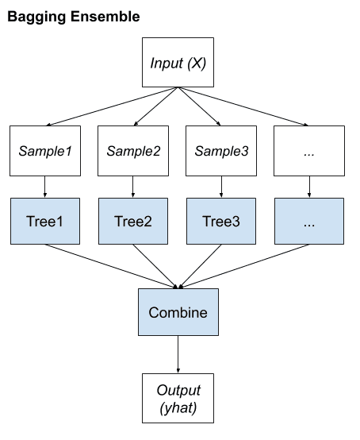
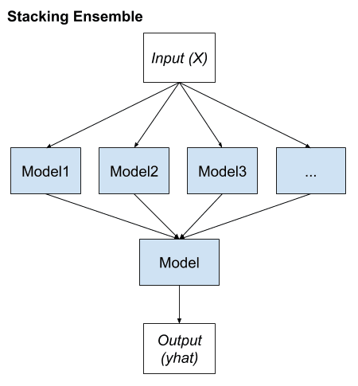
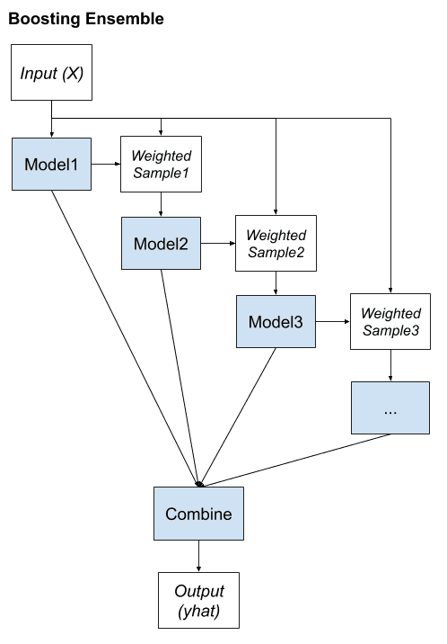
Ensemble Learning Algorithms
Ensemble learning combines the predictions from multiple models to achieve better prediction.
Graphs are from Machine Learning Mastery.

Slide 23

Machine Learning in Academica: P-value based Statistical Significance vs ML
These p-value-centric studies face two main drawbacks:
They may include statistically significant variables that don’t improve prediction
They use the entire dataset for model fitting, which limits generalizability and raises concerns about overfitting.
Null Hypothesis: my dog doesn’t destroy pillows.
Alternative Hypothesis: Yes, he does.

Slide 24
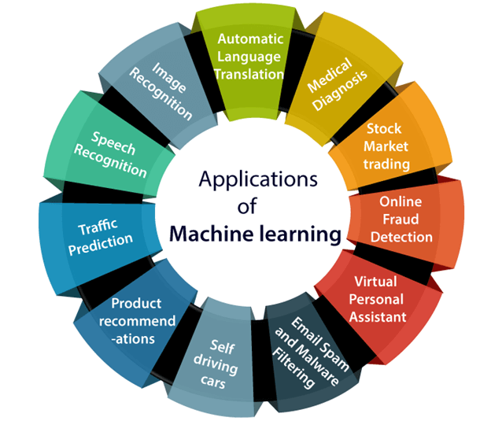

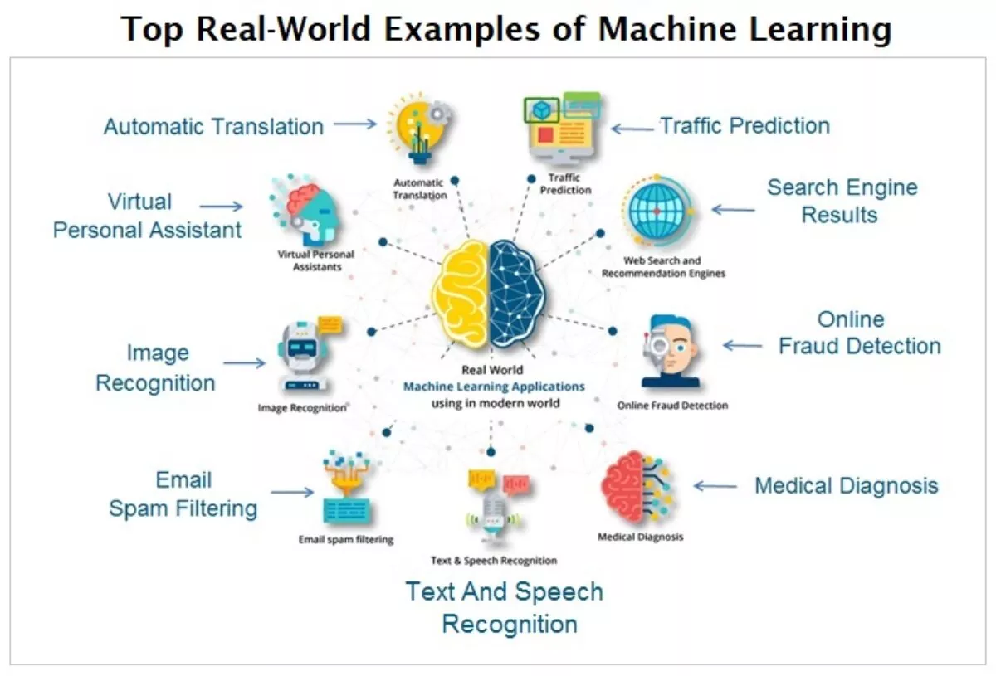
Graphs are from www.aiiottalk.com and www.javatpoint.com

Slide 25
Professionals Behind ML Applications
Machine Learning Engineer:
Focuses on designing, implementing, and deploying ML applications.
Analyzes large datasets to derive meaningful insights and patterns.
Works on advancing the state-of-the-art in ML and AI through research. May publish academic papers and propose new algorithms or methods.
Deep Learning Engineer:
Specializes in using deep neural networks to address complex problems like image and speech recognition.
AI/ML Product Manager:
Manages the development and deployment of AI/ML products. Bridges the gap between the technical team and business stakeholders.
responsible for designing and implementing AI applications
MLOps engineer
Data Science Consultant
Big Data Engineer
Artificial Intelligence Engineer
MLOps ("Machine Learning Operations") engineers focus on the deployment, testing, monitoring, and automation of ML systems in production.
uses their expertise in statistics, data analysis, and machine learning to provide actionable insights to businesses
design, construct, install, and maintain large-scale processing systems and other infrastructure
Data Scientist:
Research Scientist/Applied Research Scientist

Slide 26

Professionals Behind ML Applications
Data Engineer:
Focuses on creating robust, scalable data pipelines.
Prepares "big data" for analytical or machine learning applications.
AI Specialist/Solutions Architect:
Designs solutions based on ML and AI for specific industry needs.
Often involves integrating AI into existing systems or processes.
NLP Scientist/Engineer:
Works with algorithms related to natural language processing.
Tasks might include sentiment analysis, chatbot development, or language modeling.
Computer Vision Engineer:
Specializes in enabling machines to interpret and make decisions based on visual data.
Often used in applications like facial recognition, medical imaging, or autonomous vehicles.
AI Ethics Researcher/Officer:
Focuses on the ethical considerations of AI implementations.
Works on creating guidelines and ensuring fairness, accountability, and transparency in AI systems.

Slide 27
How Do I Start?
Prerequisites:
Mathematics: Familiarize yourself with the foundational concepts of linear algebra, probability, statistics, and calculus. These form the underpinnings of many ML algorithms.
Programming: Python is the most popular language in ML, and R is used often in statistics and data analysis. Start with Python and its key libraries such as NumPy and Pandas.
Foundational Concepts:
Introduction to ML: Understand what machine learning is, its types (supervised, unsupervised, reinforcement learning), and its applications.
Basic Algorithms: Learn about algorithms like linear regression, logistic regression, decision trees, and k-means clustering.
Intermediate ML:
Deep Dive: Explore ensemble methods (like Random Forests, Gradient Boosting Machines), SVM, and neural networks.
Evaluation: Understand metrics like accuracy, precision, recall, F1 score, ROC, and AUC. Learn about overfitting, underfitting, and how to split data (train/test/validation sets).
Software & Tools: Dive deeper into Python libraries like Scikit-learn for machine learning, and Matplotlib and Seaborn for data visualization.
Deep Learning:
Neural Networks: Learn about feedforward networks, backpropagation, activation functions, and optimization techniques.
Advanced Models: Delve into Convolutional Neural Networks (CNNs) for image tasks, Recurrent Neural Networks (RNNs) for sequence tasks, and transformers for NLP tasks.
Frameworks: Familiarize yourself with TensorFlow, Keras, or PyTorch.

Slide 28

Specialized Areas:
Computer Vision
Reinforcement Learning
Generative Adversarial Networks
Time-Series Forecasting
Projects:
Hands-On Experience: Work on small projects or Kaggle competitions.
Continuous Learning:
Regularly read research papers, articles, and engage with online community.
Resources:
Online Courses: Platforms like Coursera, Udacity, and edX offer courses from top universities and companies.
Books: "Introduction to Machine Learning with Python: A Guide for Data Scientists"
Portfolio: Document your projects. This could be beneficial when applying for jobs.
Blogs/Websites: Towards Data Science, Machine Learning Mastery, and the Google AI Blog are great resources.
Natural Language Processing
AI Specialist

Slide 29

Remember, learning ML is a journey, not a destination. Start with small steps, stay persistent, practice a lot, and over time, you will gain proficiency in the field.

Slide 30

Q&A

